Slide 1
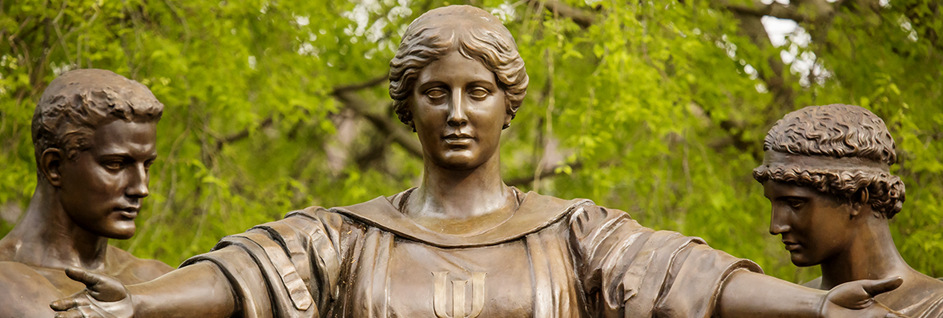
Participant Support vs. Human Subject Payments

Slide 2
Participant Support vs. Human Subject Payments
Sponsored Programs Administration
Sarah Lorbiecki, Assistant Director – NSF Awards
Joy Fuller, Assistant Director – DOE/USDA Awards

Slide 3
Definitions
Participant Support Costs (PSC):
Direct costs for items such as stipends or subsistence allowances, travel allowances, and registration fees paid to or on behalf of participants or trainees (but not employees) in connection with conferences, or training projects (2 CFR 200, Subpart A, §200.75).
Human Subject Payments:
Payment or non-monetary reward to subjects as remuneration for time and inconvenience of participation in research studies, as well as an incentive to participate. Compensation can include monetary (cash, gift cards, vouchers, etc.) and/or non-monetary (gifts/promotional items, course credit, extra credit, etc.) remuneration (https://oprs.research.illinois.edu/guidance-payments-human-subjects).

Slide 4
Participant Support in Banner
Typical Participant Support Costs - Charge to a Designated PSC Fund | Non-PSC Expenses - Charge to a Non-PSC Fund
Participant Travel – airfare, ground transportation, lodging, per diem, conference registration fees | PI Travel Costs
Stipends for REU or RET Participants | Salaries – PI, GRA, Postdocs, etc.
Lodging & Subsistence Allowances for REU or RET Participants | Speaker Travel & Honoraria
 | Conference Catering
 | Conference Room Rentals & AV Fees
 | Supplies – folders, name badges, display boards, printed materials, research supply kits, etc.
 | Collaborator Travel

Slide 5
Human Subject Payments in Banner
Charge to Banner Account Code 141200 – Human Research Subjects | Charge to Banner Account Code 154900 – Non-Employee Travel
Incentive payments for participation in research studies, including: Cash Gift Cards Amazon e-payments Amazon Mechanical Turk (MTurk) payments | Reimbursements to human subject participants, including: Parking Costs Transportation Costs (mileage)

Slide 6
Examples
Participant Support Costs | Human Subject Payments
Undergrads from developing nations attend a summer institute at UIUC to learn about American democracy and culture. Travel, lodging and subsistence allowances are provided throughout the 6-week training institute. | In a study measuring stress in undergrads majoring in Engineering fields, students are compensated with a $5 Amazon e-gift card for completing an on-line survey.
Under an NSF REU supplement, a U of I professor will host two students for a 6-week summer training course. The students will be paid a weekly stipend. Their transportation to / from campus will be covered and they will be provided with on-campus housing and a meal plan. | In a Psychology study focused on math comprehension in early elementary students, parents completed surveys and visited a lab on campus with their children. Parents and children were observed while completing research activities. Families were paid $40 in cash after each lab visit.
An NSF-funded conference will be hosted on the U of I campus. Twenty graduate students from across the US will be invited to attend. The students’ airfare/transportation, lodging and per diem will be covered by the grant. | Through an NSF-funded project, a PI is creating a prototype for virtual reality driven archaeological excavations. UIUC students will be recruited to test the prototype. Each student will be paid $20 in cash.
A U of I professor is hosting workshops in developing countries to teach sustainable farming techniques. Local farmers are paid a stipend to attend these workshops. The stipends are considered to be participant support costs. | Researchers conduct a reading activity at a local elementary school. Students are observed and teachers provide feedback. Each of the students receives $5 in cash and teachers are given a $50 gift card.

Slide 7
Participant Support vs. Human Subject Payments
 | Participant Support Costs | Human Subject Payments
Supports non-employees while participating in sponsored project funded conferences, workshops & training activities | 
Provides compensation or incentives to individuals serving as subjects in research studies |  | 
Requires prior approval from the awarding agency |  | 
Requires an approved IRB protocol |  | 
Charges will assess F&A in Banner |  | 
Separate fund will be created in Banner | 
Employees may participate or receive payment |  | 

Slide 8
Case Study
You are reviewing Professor Suze Orman’s new IMLS award. The budget justification states the following:
Participant remuneration: We have included participant incentives as follows:
$500 – Library staff interview and survey participants ($5/participant, 100 participants)
$1,000 – Young researcher focus group/survey participants ($10/participant, 100 participants)
$5,000 – Green Street Library Young Researcher Camp participants ($50 camp registration fee/ participant, 100 participants)
Do you have any concerns?

Slide 9
Case Study
Original Budget Justification | Additional Details | Purpose / Activity | Appropriate Budget Category
Library staff interview and survey participants | Green Street Library staff will administer surveys and conduct focus group interviews with the young researchers (teens ages 14 - 17 years). | Library staff is providing a service by collecting data for the research. | Other Direct Costs – Services
Young researcher focus group/survey participants | Young researchers will participate in a focus group discussion and complete surveys administered by Green Street Library staff. | The teens are being studied. Data is being gathered from/about them. | Human Subject Payments
Green Street Library Young Researcher Camp participants | Young researchers will attend a week long summer day camp focused on using library resources. | The teens are attending the camp to be trained / to participate in a learning activity. | Participant Support Costs

Slide 10
Participant Support Costs – Fun Facts
Participant Support Costs are allowable only with the prior approval of the Federal awarding agency.
The awarding agency must specifically designate funding as participant support, the University cannot “create” participant support.
Participant Support Costs are excluded from F&A.
NSF requires prior approval for reallocating PSC costs to other categories of expense. NIH requires prior approval for increasing the amount of PSC awarded.
Beware of the 149110 & 149190 Account Codes in Banner – these account codes should NOT be used on non-PSC Banner funds.

Slide 11
Human Subject Payments – Fun Facts
All research involving human subjects must be reviewed by the campus Institutional Review Board (IRB), or its approved designee. Approval must be obtained prior to any involvement of subjects.
Incentive payments made to human subjects may be taxable.
F&A will assess on human subject payments in Banner.
Payments to U.S. citizens, resident aliens & permanent residents must post to Banner Account Code 141200. Payments to non-resident aliens must post to Account Code 215985.

Slide 12
The Working Group
Participant Support vs. Human Subject Payments Working Group
Charged with developing formal guidance that differentiates between the use of Participant Support versus Human Subject Payments.
SPA Working Group Members:
Robin Beach, Associate Director – Award Negotiation
Joy Fuller, Assistant Director - DOE/USDA Awards
Sarah Lorbiecki, Assistant Director – NSF Awards
Amy Roessler, Director – Data & Enterprise Systems

Slide 13
Resources
Participant Support Costs
Uniform Guidance – Definition (2 CFR 200, Subpart A, Section 200.75)
Uniform Guidance – Prior Approval Requirement (2 CFR 200, Subpart E, Section 200.456)
NSF Proposal & Award Policies & Procedures Guide 18-1 – Participant Support Policies (Chapter II, Section C.2.g(v))
Research Terms and Conditions (RTCs)
Human Subject Payments
Office for the Protection of Research Subjects (OPRS)
OBFS Policies & Procedures, Section 8 – Payments and Reimbursements to Human Subjects

Slide 14
Questions

